Slide 1

Lesson 3.02: User-Defined Functions
Microsoft Philanthropies TEALS Program
Introduction to Computer Science
Semester 2

Slide 2
User-Defined Functions
Students will be able to...
Define and identify
abstraction
def (new Python keyword)
Create functions
Create a function contract

Slide 3
Today’s Plan
Do Now
Lesson
Lab
Debrief
Notes:
5 Minutes - Do Now
10 Minutes - Lesson
35 Minutes - Lab
5 Minutes - Debrief

Slide 4
Do Now
Write down one thing you learned in class yesterday.
Open the console. Type the following program:
def my_function():
print("THIS IS MY FUNCTION!")
Answer the following in your notebook:
What does my_function do?
How would you call the function?
How might you add arguments to my_function?
Practice calling my_function by adding code outside of the definition to invoke the function.
Notes:
Students should answer the questions in their notebook.

Slide 5
Definition
Abstraction: the process of managing complexity by removing details and pushing them down to a lower level.
Notes:
Lesson
Ask students to brainstorm why, in general, a function might be useful in programming.
Here are some items that the instructor should make sure students bring up during brainstorming
1. Abstraction: managing the complexity of a program by removing details and pushing them down to a lower level
2. Less repeated code.
3. Breaking the problem up into smaller pieces and solving each piece

Slide 6

Car Abstraction
“managing complexity by removing details and pushing them down to a lower level”

Slide 7
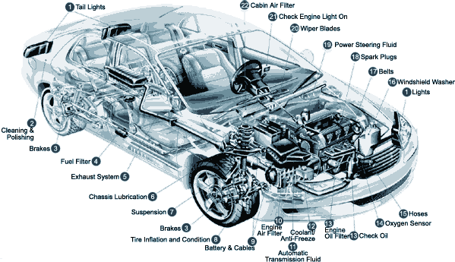
Detailed Car Abstraction
“managing complexity by removing details and pushing them down to a lower level”

Slide 8

Abstraction
Just a steering wheel. Everything else is hidden

Slide 9
Hidden - Abstraction
Just a steering wheel. Everything else is hidden behind this "abstraction".

Slide 10

Python Abstraction
Does Python provide us any abstractions?

Slide 11
Built-In Function Abstraction
randint()
print()
input()
len()
str()
...
Notes:
Yes! All the built-in functions we’ve seen so far are abstractions. They abstract away the details of taking user input, printing to the console, etc. and just do it for you! These simplify our programs by giving us pre-defined components onto which we can build. We can take this further by making our own abstractions!

Slide 12
A User-Defined Function = your own abstractions!
def my_function(a, b):
“Define” a function
Name of function
Arguments
Notes:
“def” is a new keyword for us. It allows us to define a function of name “multiple_by_two” with argument “num”.

Slide 13
Practice
Record this in your notebook:
Create a function that takes two arguments.
In the body of the function, add the two values together.
Return the sum.
def my_function(a, b):
c = a + b
return c
# Example: now we can call the function!
print("2 plus 3 equals",my_function(2,3))
Notes:
Have students practice making a function that takes two arguments, adds them together, and returns the sum.
Example Code
def my_function(a, b):
c = a + b
return (c)

Slide 14
Function Contract
Using # to create comments, the function contract should specify
The name of the function
An explanation of the function's purpose
A list of the arguments it takes in and the types of those arguments
The function's return type
Notes:
Introduce the concept of a function contract using #, which adds a comment (non-executed line of code)
The function contract should
specify the name
explain the purpose
list what arguments it takes in and the types of those arguments
specify the return type

Slide 15
A User-Defined Function
# Name: multiply_by_two
# Purpose: multiplies a given number by 2
# Input: number to multiply (int)
# Returns: int
def multiply_by_two(a):
c = a * 2
return c
Notes:
Whenever we define a new function, it is also crucial that we define what’s called a “contract”. It is a comment before the function that says to the programmer reading your code what the function does. Why is it important to include a contract?

Slide 16
Lab - Part 1: Happy Birthday
Create a function called birthday_song
Print out the Happy Birthday song
A name is input as an argument
The contract should be:
# Name: birthday_song
# Purpose: birthday_song prints out a personalized birthday song
# Input: name, string
# Returns: none
def birthday_song(name):
# your code goes here

Slide 17
Lab - Part 2: Pick 5 Cards
Create a function that randomly selects and prints out 5 cards in a row, from a standard deck of cards.
NOTE: The cards can repeat -- it's okay if the same card shows up multiple times.
Write out the contract for this pick_5_cards() function.
Starter code:
numbers = ['A', '2', '3', '4', '5', '6', '7', '8', '9', '10', 'J', 'Q', 'K']
suits = ['Spades', 'Clubs', 'Diamonds', 'Hearts']
Notes:
number = ['A', '2', '3', '4', '5', '6', '7', '8', '9', '10', 'J', 'Q', 'K']
suit = ['Spades', 'Clubs', 'Diamonds', 'Hearts']

Slide 18
Bonus!
1) Practice passing in lists as arguments to a function.
E.g., pass in numbers and suits lists to a modified pick_5_cards() function. Modify the code to use those passed-in lists to make the card selections.
What is different about passing in lists as arguments?
2) Similarly, try returning a list as the return value (output) of a function.
For example, have the pick_5_cards() function return a list of selected cards instead of printing anything inside the function. After calling the function, have the main part of your code print out the list of cards that was returned.
Notes:
Students can answer the question in their notebooks

